Slide 1


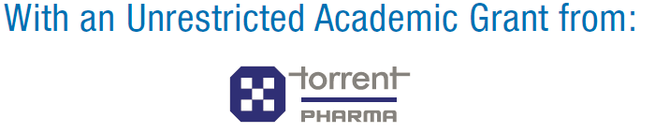

Slide 2
CMC - Kochi 2018 – Executive Summary
Sr No | Particulars | Details
1 | Event Name | Cardio Metabolic Conclave 2018 Event Organized by AAME (Academy of Advance Medical Education)
2 | Date & Venue | 23rd September 2018 Grand Hyatt Kochi Bolgatty
3 | Course Director | Dr. C G Bahuleyan, Trivandrum
4 | Scientific Chairman | Dr. Tiny Nair, Trivandrum
5 | Total No of Delegates | 104
6 | Academic partner | Torrent Pharma

Slide 3
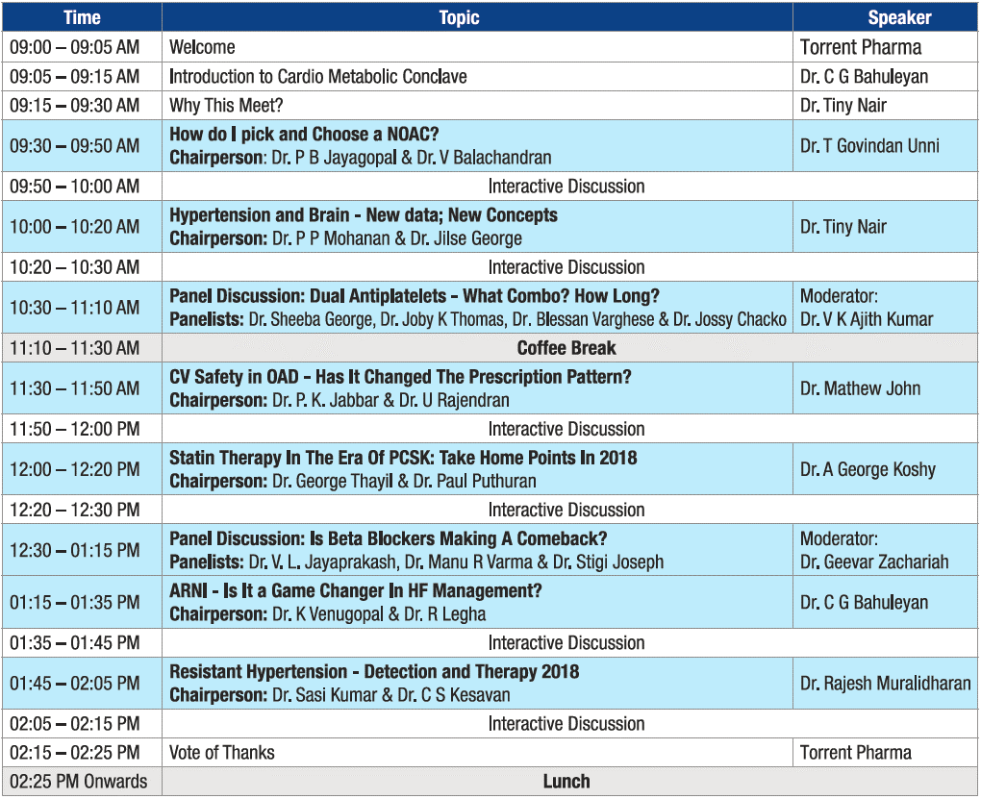
Agenda

Slide 4
Event Summary
Cardio Metabolic Conclave is designed in such a way, where in-depth scientific discussion was held on various topics covering all the major specialties like Cardiology, Diabetology, Endocrinology & Nephrology
Overall topic selection, content & the program is very well appreciated by all the delegates
Panel discussion on DAPT & Beta-blockers has given good insight regarding the therapy
Detailed discussion on NOACs, ARNI & Statins has given better clarity for the management of the diseases
In-depth discussion on Hypertension management, newer guidelines on Hypertension & resistant Hypertension was well appreciated
A Quiz session after every topic with voting pad was well accepted and helped to generate more interest towards the program
Live video recording was done for entire scientific agenda
All Speakers, Chairpersons, Moderator, Panelists, Scientific Chairman & Course Director honored with a Memento as a token of appreciation

Slide 5
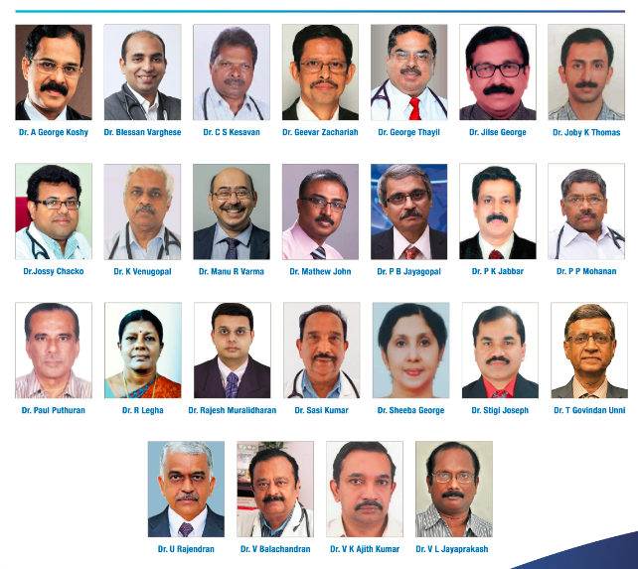
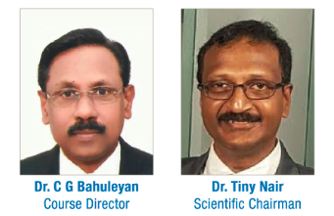
Esteemed Faculty

Slide 6
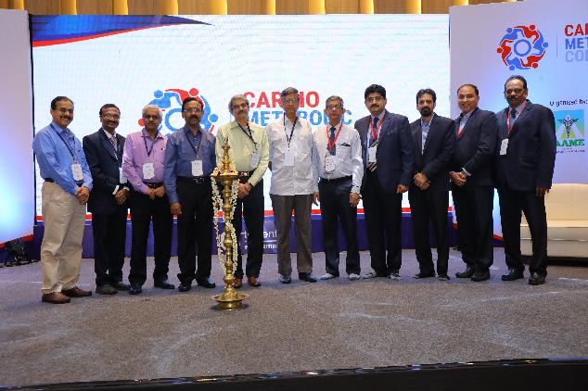
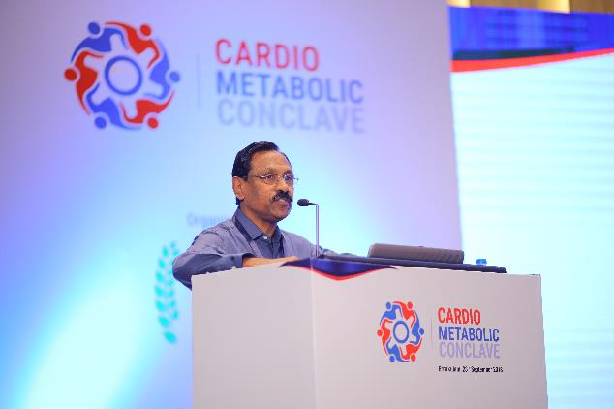
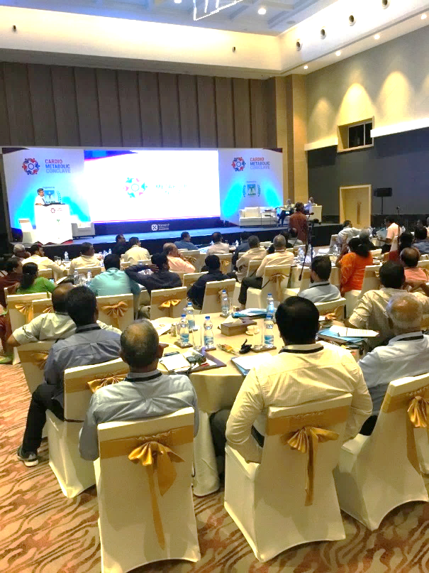
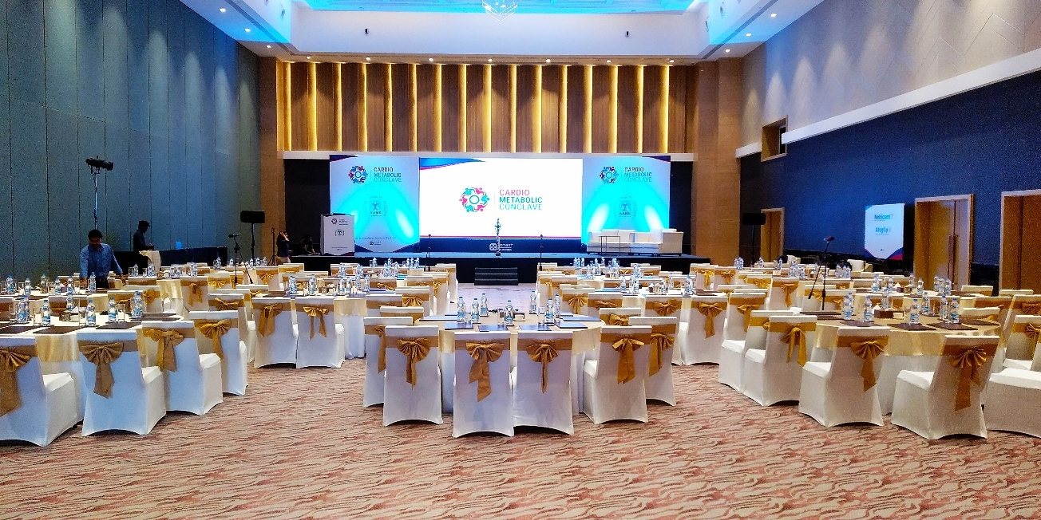
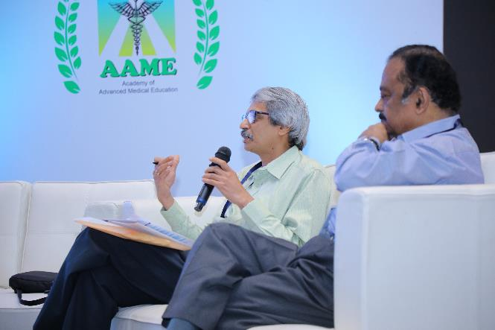
Event Gallery

Slide 7
Thank You !!!

