Slide 1
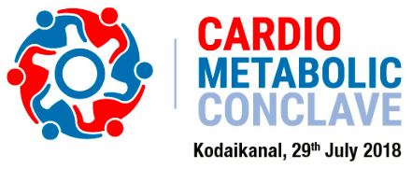

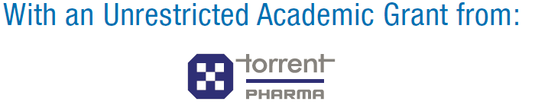

Slide 2
CMC Kodaikanal 2018 – Executive Summary
Sr No | Particulars | Details
1 | Event Name | Cardio Metabolic Conclave 2018 Event Organized by AAME (Academy of Advance Medical Education)
2 | Date & Venue | 29th July 2018 The Carlton, Kodaikanal
3 | Course Director | Dr. N. Sivakadaksham (Cardiologist) Chennai
4 | Total No of Speakers | 9
5 | Total No of Delegates | 65
6 | Academic partner | Torrent Pharma

Slide 3
Agenda
Time | Session/Topic | Speaker
09:30-09:45 AM | Welcome and Introduction
09:45-10:05 AM | CAD in Diabetes – Are they Equivalent? | Dr. N. Sivakadaksham Cardiologist
10:05-10:25 AM | 2018: Guiding through Guidelines in Hypertension | Dr. D. Prabhakar Cardiologist
10:25–10:40 AM | Interactive Discussion
10:40-11:00 AM | Effective management of Diabetes with Kidney disease | Dr. J. Balasubramaniam Nephrologist
11:00-11:20 AM | 2018: Focused Update on Dual Anti-Platelet Therapy | Dr. Sundar C. Cardiologist
11:20-11:30 AM | Interactive Discussion
11:30-11:50 AM | TEA BREAK
11:50-12:10 PM | Newer Drug in All Situations | Dr. N. Bhavatharini Diabetologist
12:10-12:30 PM | Male Sexual Dysfunction in Diabetes Mellitus | Dr. S. Sridhar Endocrinologist
12:30-12:40 PM | Interactive Discussion
12:40-01:00 PM | MI & Cardiogenic Shock | Dr. B. Madan Mohan Cardiologist
01:00-01:10 PM | Interactive Discussion
01:10- 02:00 PM | LUNCH
02:00-02:20 PM | NOACs in Clinical Practice: A patient Centered Approach | Dr. M. Kathiresan Cardiologist
02:20-02:40 PM | New Drugs in Heart failure | Dr. B. Vinod Kumar Cardiologist
02:40-02:50 PM | Interactive Discussion
02:50-03:15 PM | Open Discussion – Management of Lipid Disorders in DM, Non DM & Renal Patients | All Faculties – PANEL DISCUSSION
03:15-03:30 PM | Closing Remark and Vote of Thanks

Slide 4
Event Summary
Cardio Metabolic Conclave is designed in such a way, where in-depth scientific discussion was held on various topics covering all the major specialties like Cardiology, Diabetology, Endocrinology & Nephrology
A brief discussion on Newer Guidelines on Hypertension & Heart Failure were the most appreciated topics by the doctors
Panel discussion on NOACs has given good insights on therapy
Healthy discussion on Diabetes, newer drugs in Diabetes & male Sexual Dysfunction due to Diabetes which has given good clarity to deal with the disease
A Quiz session on newer drug in Heart Failure has created good interest level for the topic
Feedback received from the delegates that the selection of topics were excellent
Live photography session was well appreciated by all the delegates as the view of the location was excellent
All Speakers, Chairpersons & Course Director honored with a Memento as a token of appreciation

Slide 5
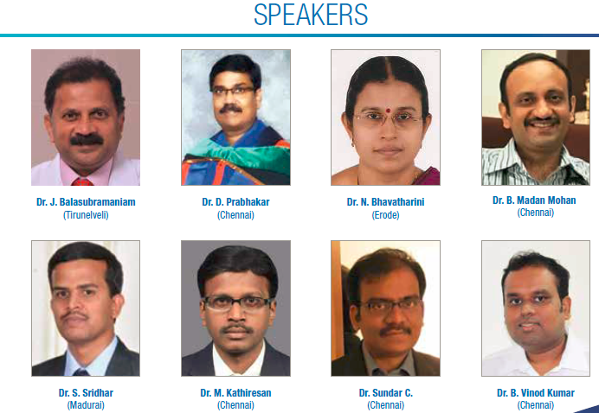
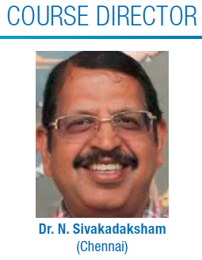
Esteemed Faculty

Slide 6
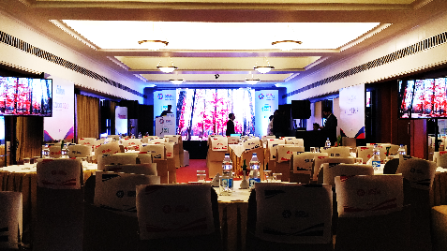
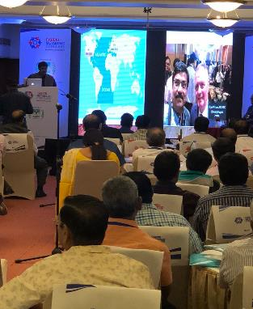
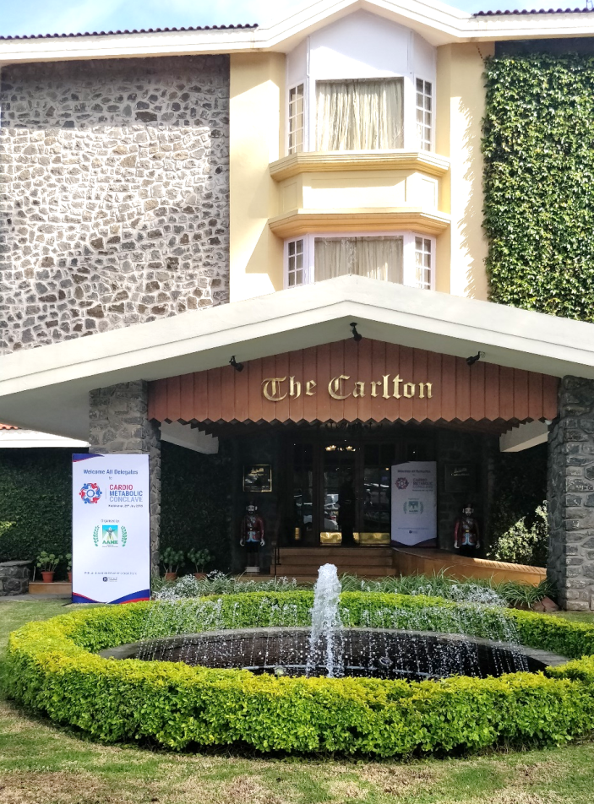
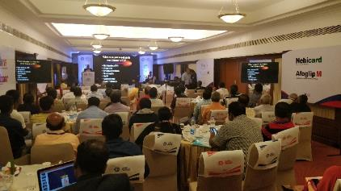
Event Gallery

Slide 7
Thank You !!!

